Slide 1





FROM WITNESS
TO CHANGE
Team:AlgoAllies
Hana Ali
Manish Kumar Jawalkar

Slide 2




Agenda
1
3
Introduction
Our Solution
2
4
Problem Statement
How the website works

Slide 3
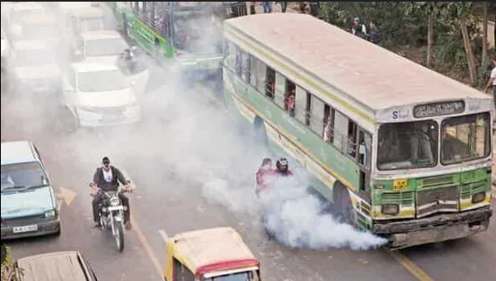
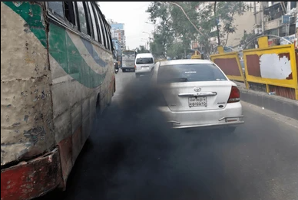
Introduction
HAVE YOU EVER WITNESSED...
What did you do?
Probably nothing—just covered your nose and moved on.
But did that solve the problem? No.
Now, imagine if you could do something about it—A REAL SOLUTION.
Not just a reaction.
It’s time to act!!

Slide 4

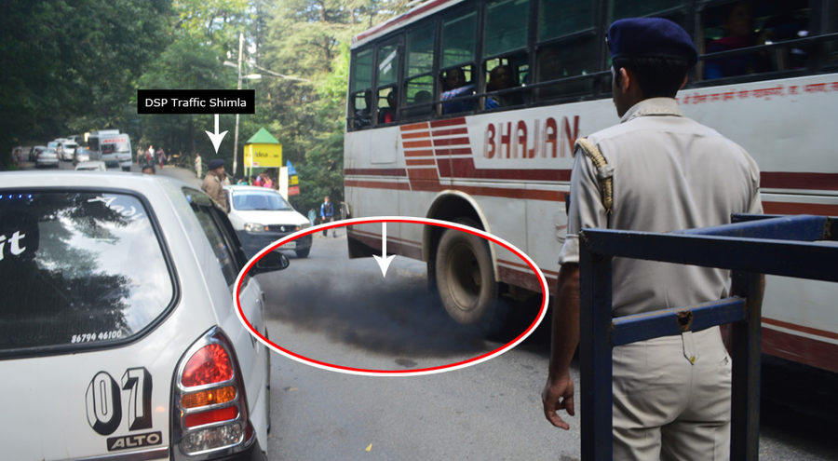
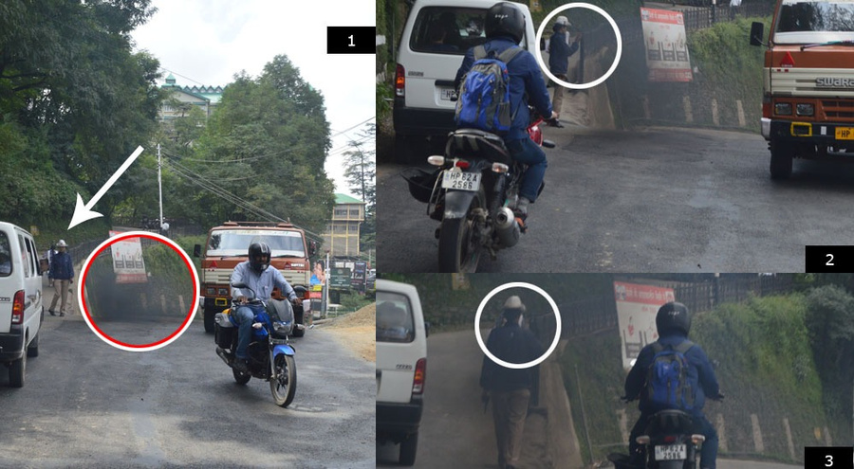

Problem Statement
Many vehicles emit excessive smoke, worsening air pollution.
No efficient system to report such vehicles in real-time.
Pollution control authorities lack direct public input.
Weak enforcement of PUC regulations worsens the problem.

Slide 5
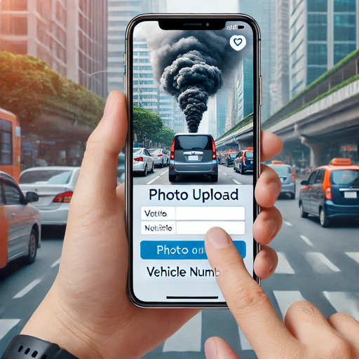

Our Solution
A WEB PLATFORM where users can report polluting vehicles.
Users submit specific details.
Data is sent to pollution control authorities.
Users get rewards for contributing.

Slide 6

How It Works
3️⃣ Submit & Get Rewarded (after verification).
1️⃣ Spot a high-emission vehicle
2️⃣ Upload details on our web (Photo/Video + Number Plate)
4️⃣ Authorities take action on the vehicle.

Slide 7
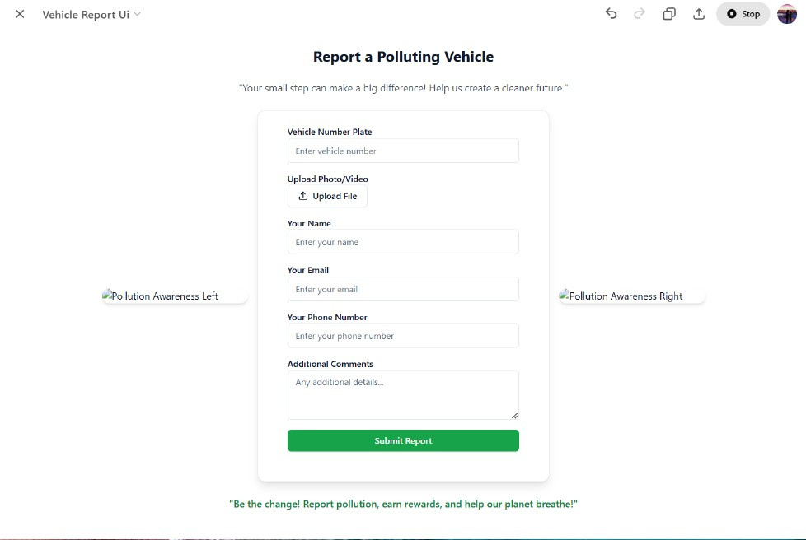

Website Preview

Slide 8

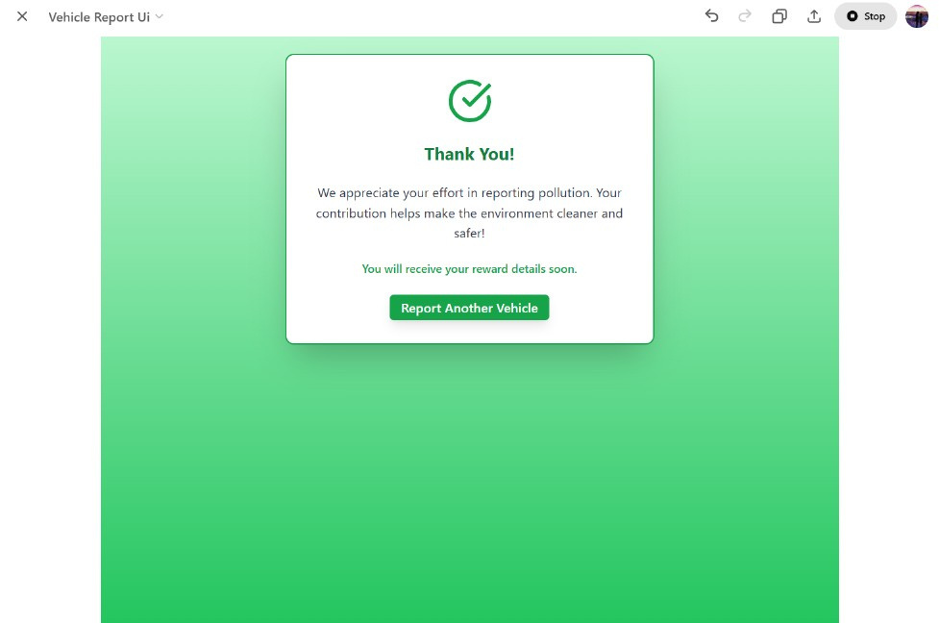


Slide 9
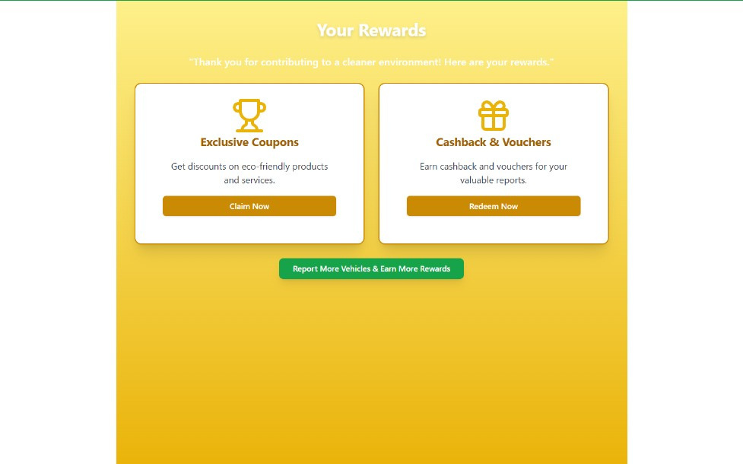


Slide 10




Strength in Numbers
When individuals unite for a shared goal, their collective voice has the potential to influence policies, practices, and industries.
Awareness
IMPACT AND BENEFITS
Encourages public participation in pollution control.
Reduces vehicle emissions by tracking offenders.
User Friendly
Supports authorities with real-time crowd-sourced data.
Incentivizes eco-friendly actions through rewards.

Slide 11

Future Scope 🚀
AI-based filtering to detect fake reports.
Integration with government databases for automated tracking.
Mobile app development for easier reporting.

Slide 12

Questions and Discussion
We invite your questions, thoughts, and ideas.
How do you think our website can help reduce vehicular pollution?
Would you be willing to use our platform to report polluting vehicles? Why or why not?
What features would make the reporting process easier for users?
How can we spread awareness and encourage more people to use the platform?
What challenges do you think we might face in implementing this solution?

Slide 13


it's time to take action!
Take a step FORWARD to make a positive impact, by reporting any polluting vehicle you come across.
Contact us at algoallies10@gmail.com

